Slide 1
Teradata CoE
Teradata Lab Course
CONTENTS :
1.
2.
3.
4.
5.
6.
7.
8.
9.
Aggregation Function
Basic SQL Function
Collect Statistics
Data Manipulation Language (DML)
Date Functions
Distinct Vs Group By Functions
Explain
Format Functions
Help and Show
10.
11.
12.
13.
14.
15.
16.
17.
18.
19.
20.
21.
22.
23.
24.
25.
26.
Join Functions
Join Indexes
Math Functions
OLAP Functions
Substrings and Positioning Functions
Temporal Tables Create function
Temporary Tables
Teradata Parallel Transport
The Quantile Function
Top SQL Command Cheat Sheet
View Functions
The Where Clause
Sample
Set Operators functions
Statistical Aggregate Functions
Stored Procedure Functions
Sub Query Functions

Slide 2
Teradata CoE
Teradata Lab Course
Set 1 :
1)
2)
3)
4)
5)
Aggregation Function
Basic SQL Function
Collect Statistics
Data Manipulation Language (DML) Date Functions

Slide 3
Teradata CoE
Teradata Lab Course
Aggregation Function

Slide 4
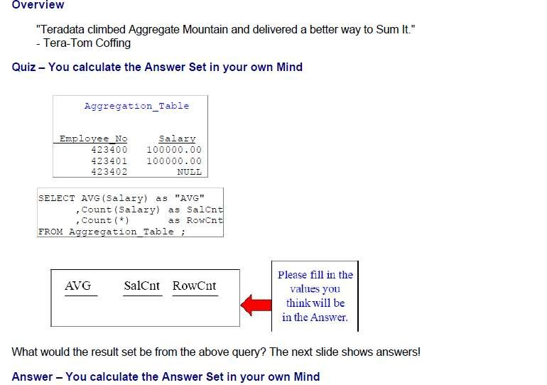
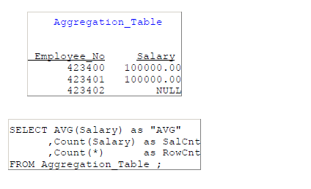
Teradata CoE
Teradata Lab Course
Aggregation Function

Slide 5
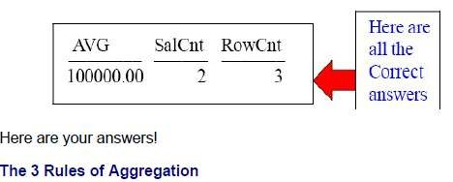
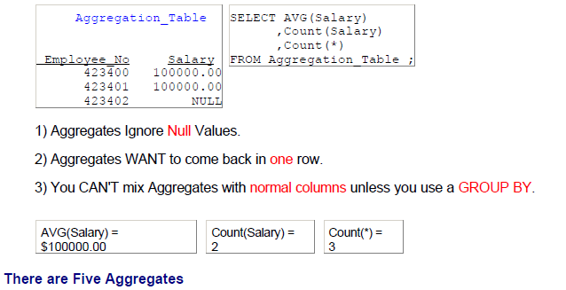
Teradata CoE
Teradata Lab Course

Slide 6
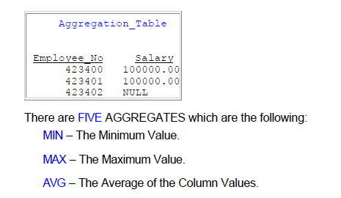
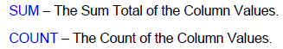
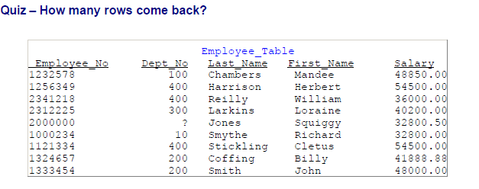
Teradata CoE
Teradata Lab Course

Slide 7
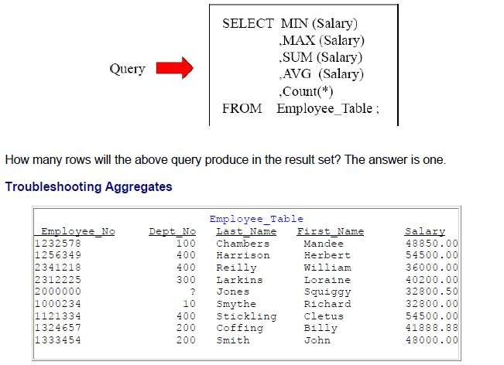
Teradata CoE
Teradata Lab Course

Slide 8
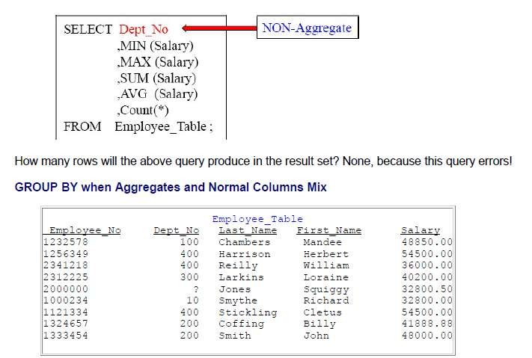
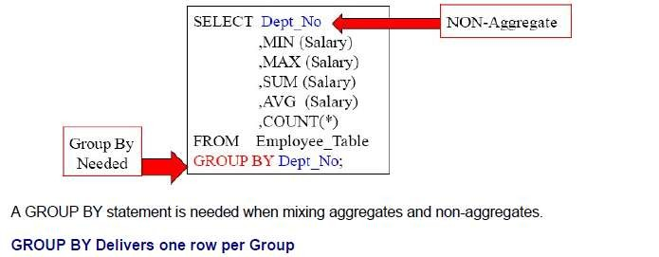
Teradata CoE
Teradata Lab Course

Slide 9
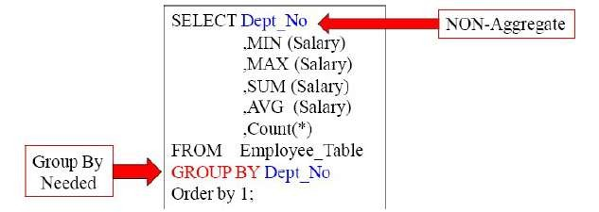
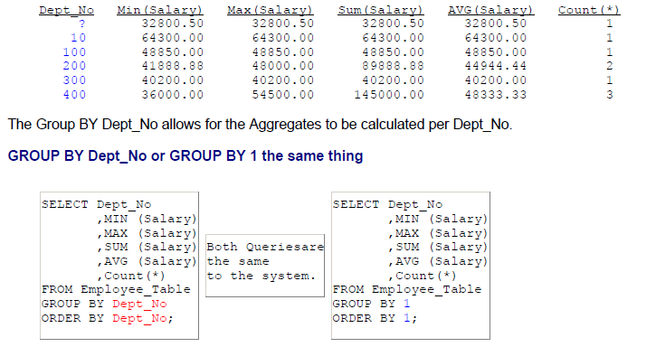
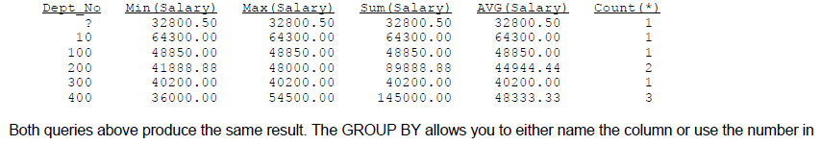
Teradata CoE
Teradata Lab Course

Slide 10
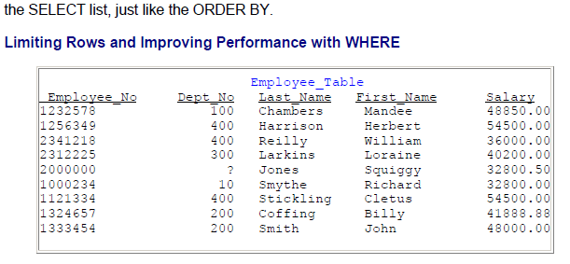
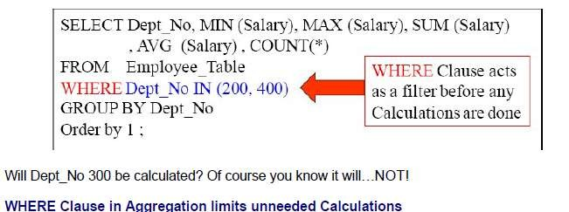
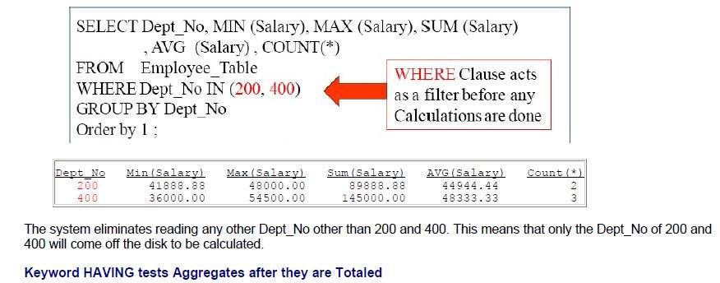
Teradata CoE
Teradata Lab Course

Slide 11
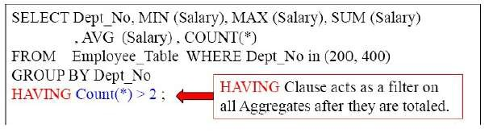
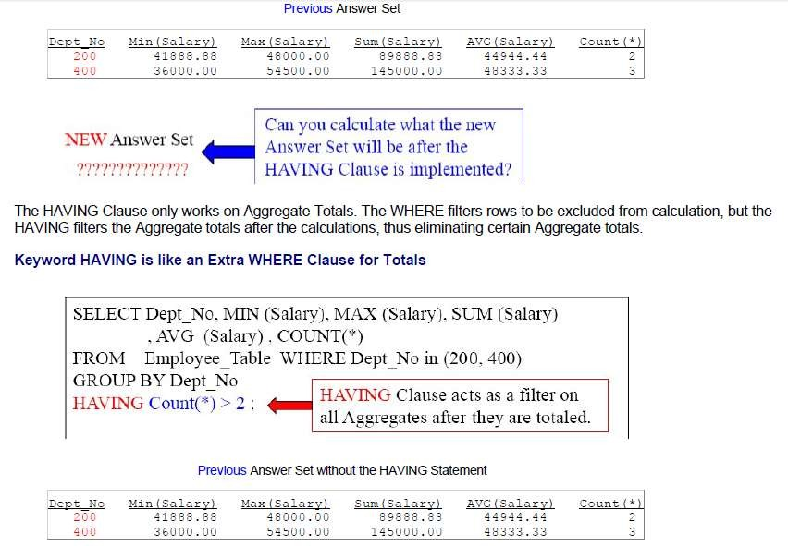
Teradata CoE
Teradata Lab Course

Slide 12
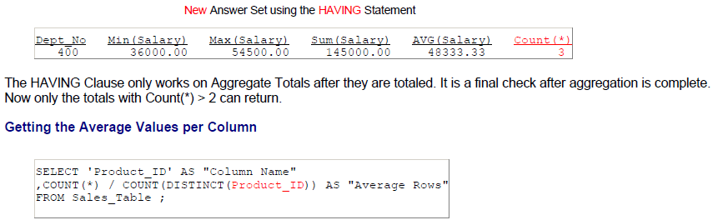
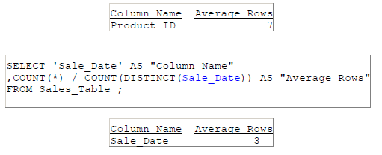
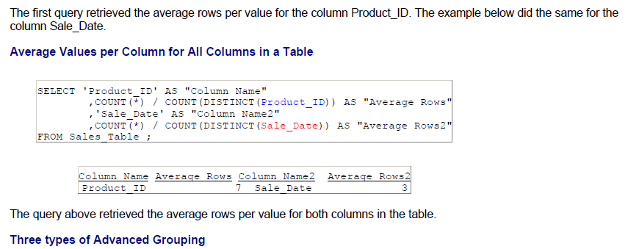
Teradata CoE
Teradata Lab Course

Slide 13
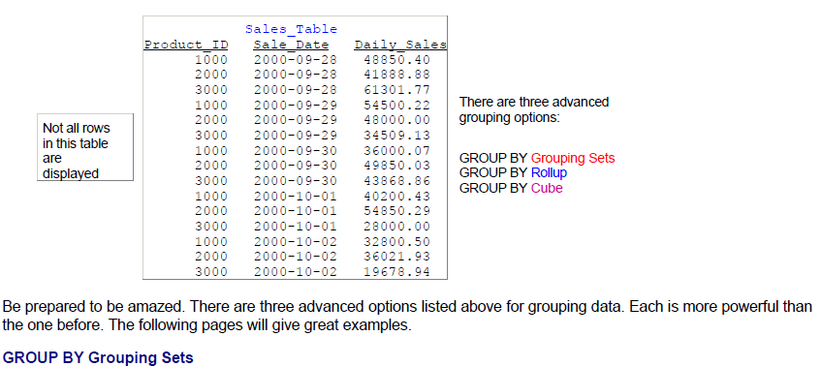
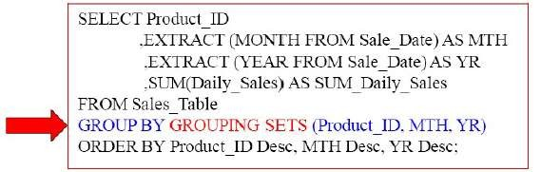
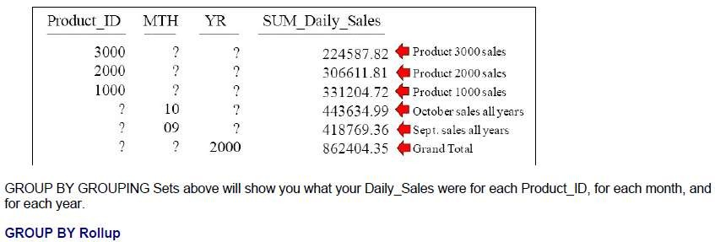
Teradata CoE
Teradata Lab Course

Slide 14
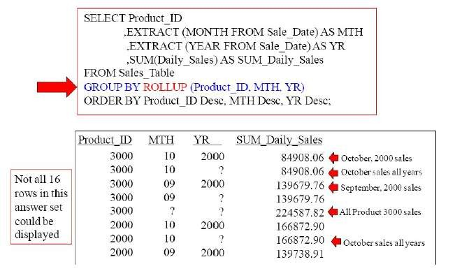
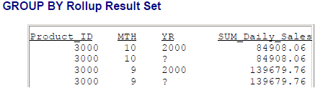
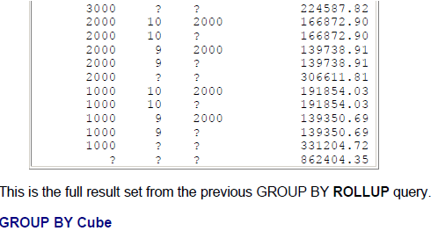
Teradata CoE
Teradata Lab Course

Slide 15
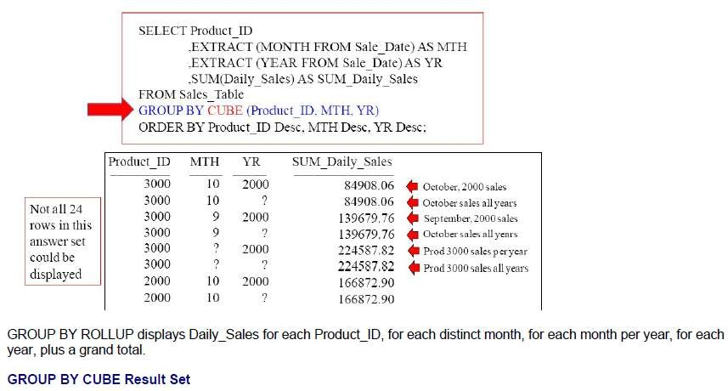
Teradata CoE
Teradata Lab Course

Slide 16
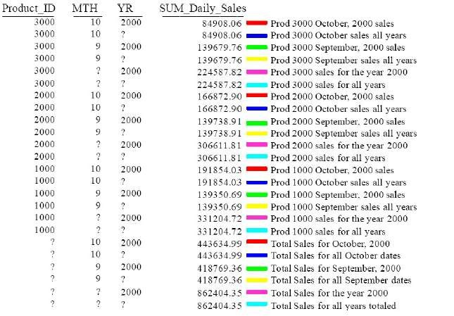
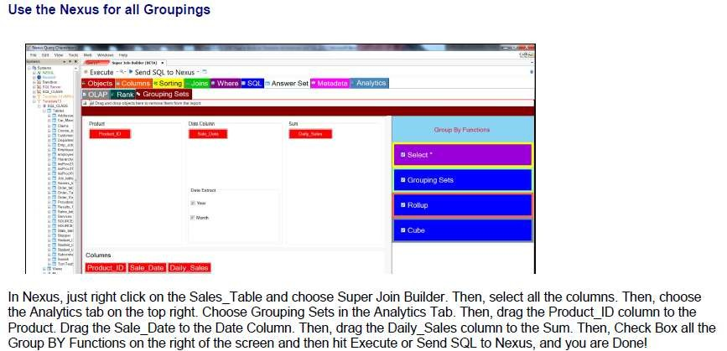
Teradata CoE
Teradata Lab Course

Slide 17
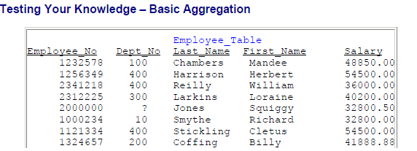
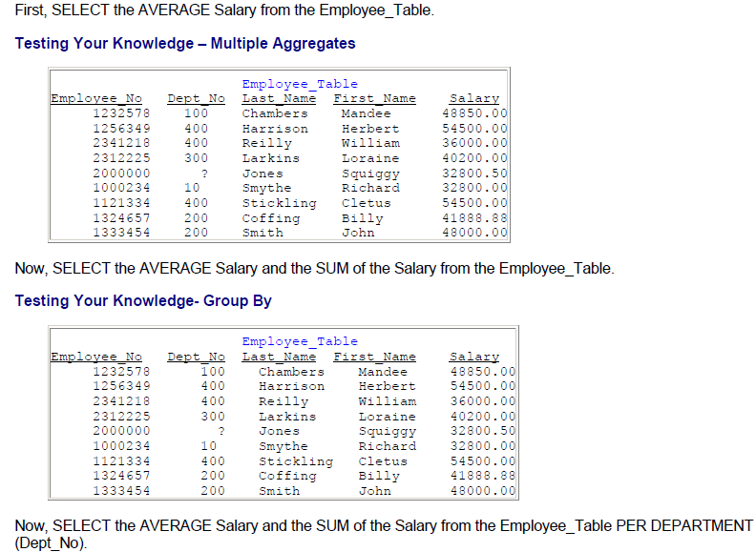
Teradata CoE
Teradata Lab Course

Slide 18
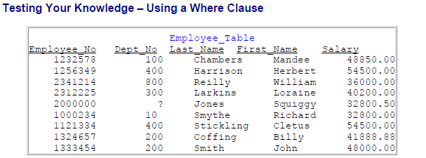
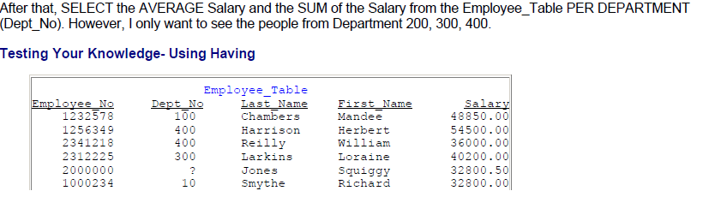
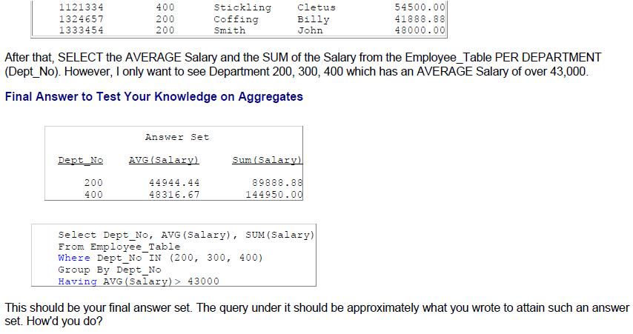
Teradata CoE
Teradata Lab Course

Slide 19
Teradata CoE
Teradata Lab Course
Basic SQL Functions

Slide 20
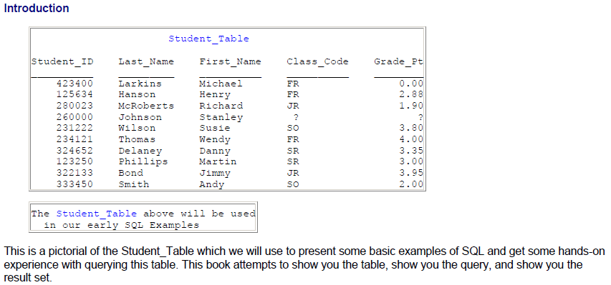
Teradata CoE
Teradata Lab Course
Basic SQL Functions

Slide 21
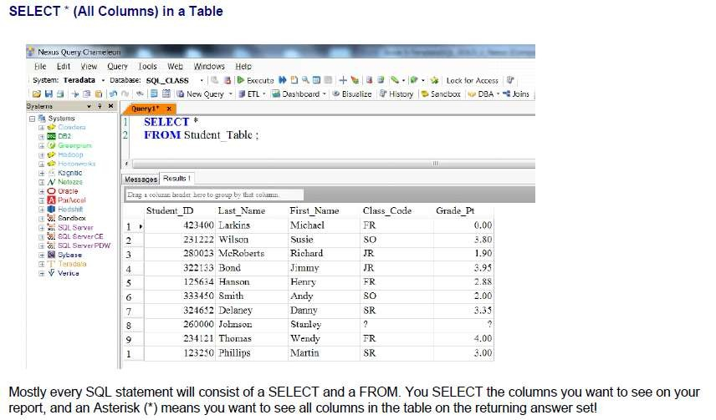
Teradata CoE
Teradata Lab Course
SELECT Specific Columns in a Table

Slide 22
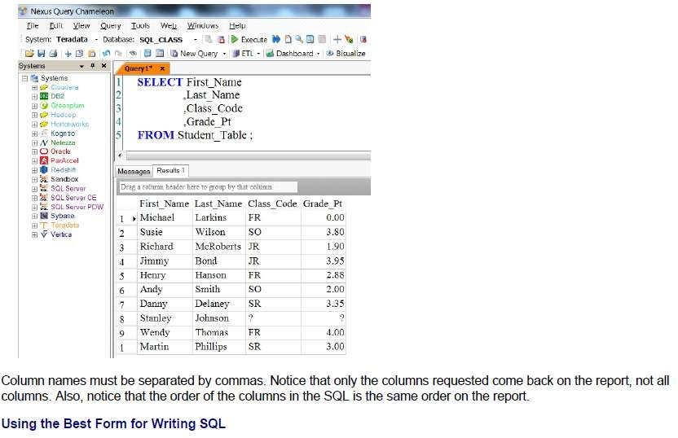
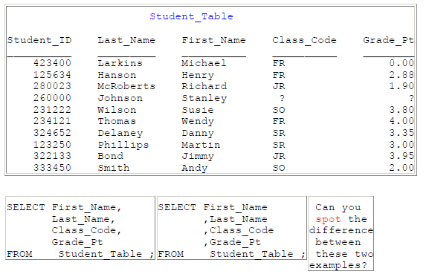
Teradata CoE
Teradata Lab Course
Why is the example on the right better even though they are functionally
equivalent?

Slide 23
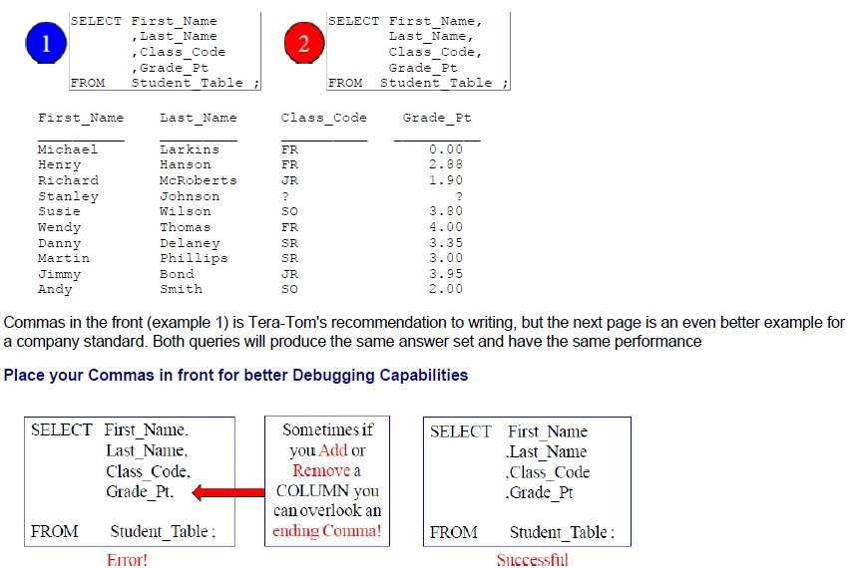
Teradata CoE
Teradata Lab Course
Commas in the Front or in the Back?
Having commas in front to separate column names makes it easier to debug.
Sort the Data with the ORDER BY Keyword

Slide 24
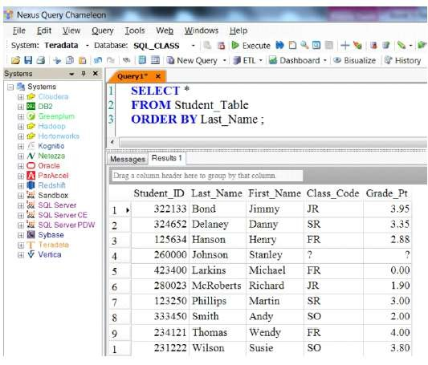
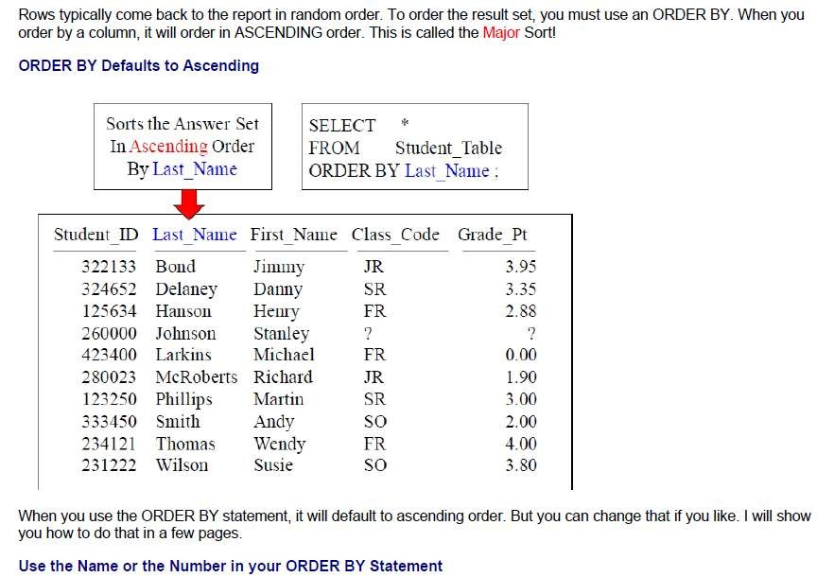
Teradata CoE
Teradata Lab Course

Slide 25
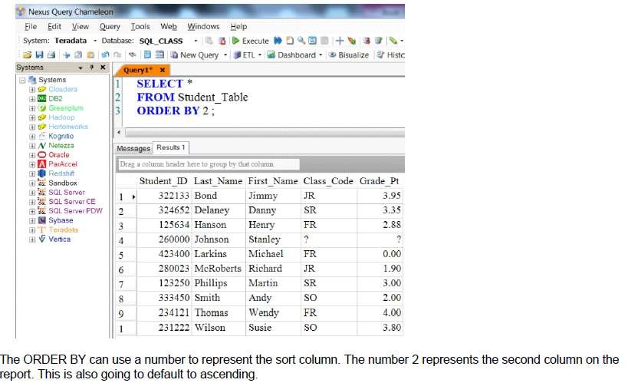
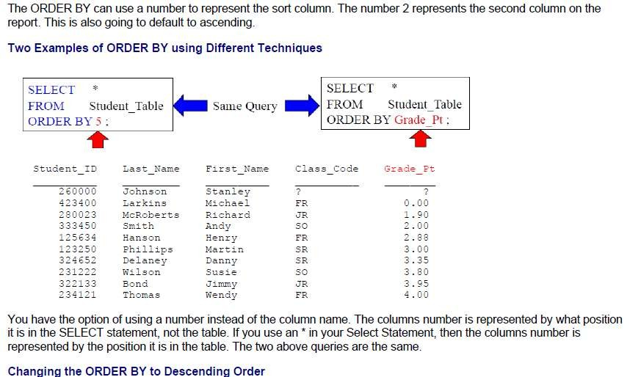
Teradata CoE
Teradata Lab Course

Slide 26
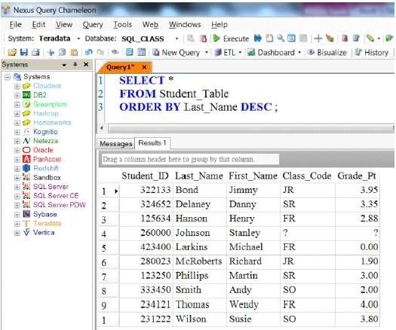
Teradata CoE
Teradata Lab Course

Slide 27
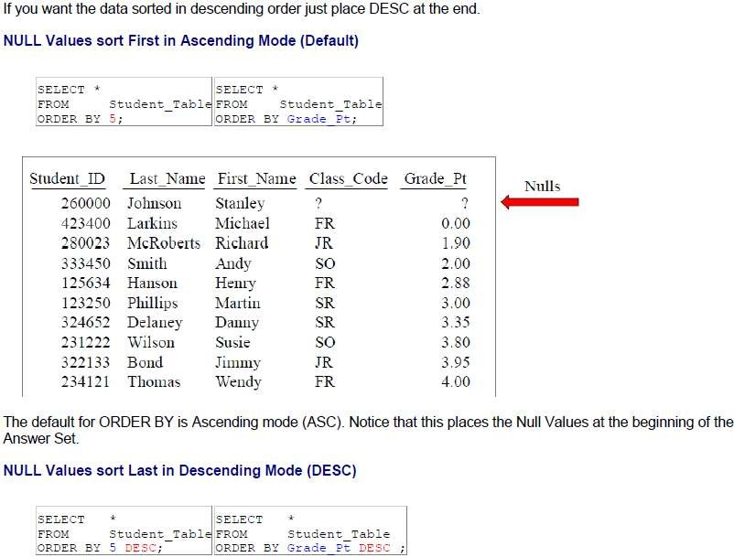
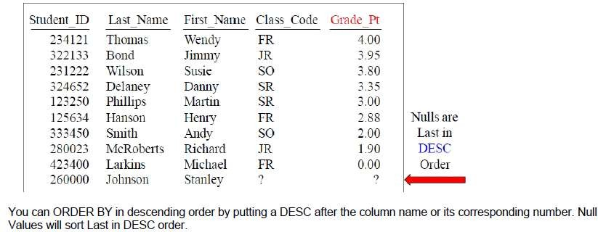
Teradata CoE
Teradata Lab Course

Slide 28
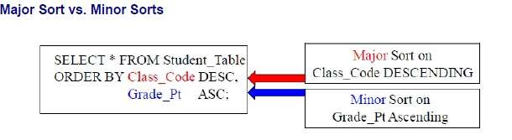
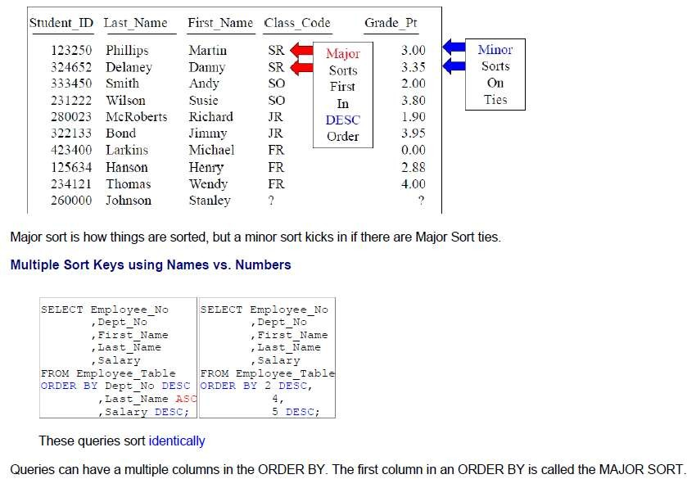
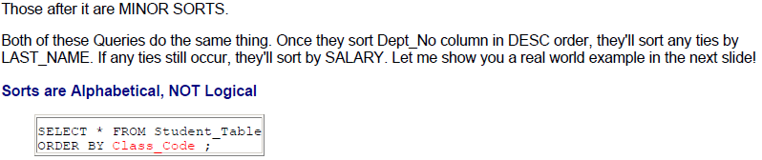
Teradata CoE
Teradata Lab Course

Slide 29

Teradata CoE
Teradata Lab Course

Slide 30


Teradata CoE
Teradata Lab Course

Slide 31



Teradata CoE
Teradata Lab Course
The Title Command and Literal Data

Slide 32


Teradata CoE
Teradata Lab Course

Slide 33


Teradata CoE
Teradata Lab Course
Sometimes you get an error in your SQL, and it is difficult to find. When our first
query ran, it produced an error. We were not sure if our Class_Code was the error, so we commented that line out and ran our SQL again. Everything ran perfectly the next time, so we knew the Class_Code line must have been the

Slide 34
Teradata CoE
Teradata Lab Course
error. What was the error? The alias Sum is a reserved word. Comments can be
used to test lines for errors.

Slide 35
Teradata CoE
Teradata Lab Course
Collect Statistics

Slide 36

Teradata CoE
Teradata Lab Course
Collect Statistics

Slide 37

Teradata CoE
Teradata Lab Course
Histogram Quiz

Slide 38


Teradata CoE
Teradata Lab Course

Slide 39

Teradata CoE
Teradata Lab Course
What to COLLECT STATISTICS On?

Slide 40

Teradata CoE
Teradata Lab Course

Slide 41

Teradata CoE
Teradata Lab Course

Slide 42

Teradata CoE
Teradata Lab Course

Slide 43

Teradata CoE
Teradata Lab Course

Slide 44

Teradata CoE
Teradata Lab Course

Slide 45

Teradata CoE
Teradata Lab Course

Slide 46

Teradata CoE
Teradata Lab Course

Slide 47

Teradata CoE
Teradata Lab Course

Slide 48

Teradata CoE
Teradata Lab Course

Slide 49

Teradata CoE
Teradata Lab Course

Slide 50

Teradata CoE
Teradata Lab Course

Slide 51



Teradata CoE
Teradata Lab Course

Slide 52






Teradata CoE
Teradata Lab Course
To collect sample statistics using the system default sample:
COLLECT STATISTICS USING SYSTEM SAMPLE COLUMN Product ID ON Sales
Table
To collect sample statistics by scanning 15 percent of the rC1Ws and use 100 intervals:
COLLECT STATISTICS USING SAMPLE 15 PERCENT AND MAXINTERVALS 10
COLUMN Product ID AS Product Stats ON Sales Table;
To change sample statistics to 20 percent (for Product_lD) and use 250 intervals:
COLLECT STATISTICS USING SAMPLE 20 PERCENT AND MAXINTERVALS 25
COLUMN Product ID AS Prod stats ON Sales Table;
To display the COLLECT STATISTICS statements for a table
SHOW STATISTICS ON Sales Table;
To display statistics details - summary section, high bias values, and intervals
SHOW STATISTICS VALUES COLUMN Product ID ON Sales Table;
How to Collect Statistics on a PPI Table on the Partition
Here is the syntax for collecting statistics on a PPI table.
COL�ECT STAT:ST:cs on <Tablename> COLUMN p�_qTrT:ON;
Here is an actual example
ko�LEC: STATISTICS on Order Table PPI COLUMN PARTITION;
Three reasons to Collect on the Partition:
0
The Parsing Engine will have a better plan for PPI Tables.
e
This h� the most with Partition Elimination on Range Queries.
e
This is especially helpful when a table has a lot of empty partitions.
The Parsing Engine can use this infonnation to better estimate the query cost when there are a significant number of empty partitions. If PARTITION statistics are not collected, empty partitions may cause the Parsing Engine to
underestimate the number of rows in a partition. You shouldn't use WITH SAMPLE to collect on Partitions.
Teradata V12 and V13 Statistics Enhancements
In V12 Extrapolate Statistics is designed to more accurately provide for a statistical estimate for date range-based queries that specify a "future" date that is outside the bounds of the current statistics. This results in less re-collections.
In V12 Stale Statistics Detection compares the Random AMP Sample with the statistics collected and determines if they are stale, and should not be used.
In V13 Statistics can now be collected on Volatile Tables.
In V13 PARTITION statistic capabilities have been added to Global Temporary Tables. In V13 Multi-Column statistics are now available on Hash and Join Indexes.

Slide 53

Teradata CoE
Teradata Lab Course

Slide 54

Teradata CoE
Teradata Lab Course

Slide 55
Teradata CoE
Teradata Lab Course
Data
Manipulation Language

Slide 56
Teradata CoE
Teradata Lab Course
Data Manipulation Language (DML)

Slide 57

Teradata CoE
Teradata Lab Course

Slide 58


Teradata CoE
Teradata Lab Course

Slide 59

Teradata CoE
Teradata Lab Course

Slide 60


Teradata CoE
Teradata Lab Course

Slide 61

Teradata CoE
Teradata Lab Course

Slide 62

Teradata CoE
Teradata Lab Course

Slide 63

Teradata CoE
Teradata Lab Course

Slide 64









Teradata CoE
Teradata Lab Course
DE:,ETE PROM My Table �aj
DEL My Table ;]
Both examples will delete all the rows in the table.
Since the FROM and the ALL are optional, and the DELETE can be abbreviated, the second example still removes all rows from a table and executes exactly the same as the above statement.
A DELETE Example Deleting only Some of the Rows
DELETE tROM My Table
HERE Column6 < 1001131
The DELETE example above only removes the rows that contained a date value less than 1001231 (December 31, 2000)
in Column6 (DATE, data type) and leaves all rows newer than or equal to the date.
Subquery and Join DELETE Command Syntax
1l1e subquery syntax for the DELETE s1a1emen1 raiows:
DEL[ETE) <table-name>
WHERE <column-name> [_, <column-name> J
:11 (SE:.ECT <column-name> (._, <column-name>
FROM <table-name> ( AS <alias-name>
WHERE condition -
)
A:.L
The join syntax for DELETE statement fOIIOws:
OE:.(ETE] <table-name>
[ FROM <�able-name> [ AS <alias-name>] J
ANJ <condicion> }
[ OR <condition> J ( P.:.L
WHER£ <�able-name>.<column-name>=<�able-na�e>.<column-narne
Sometimes it is desirable to delete rows from one table based on their existence in or by matching a value stored in
another table. For example, you may be asked to give a raise to all people in the Awards Table. To access these rows from
another table for comparison, a subquery Of a join operation can be used.
Example of Subquery DELETE Command
To remove rows from My_Table using another table called Control_Del_Toi, the next DELETE uses a subquery operation to accomplish the operation.
DELETE FROM My Table
�EERE Colu,:,.n2 IN ( SELECT Colunn2 :ROM Cont=ol �l Tbl
W'::ERE Co LuzmS > 5000 J'_O Co:.um..;,� :s NUL:. )
The above uses a Subquery and the DELETE command.
Example of Join DELETE Command
To remove the same rows from My_Table using a join with the table called Control_Del_Tbl, the folowing is another leclvlique to accomplish the same DELETE operation as the subqueiy exa� on the previous page.
m::.ETE My Tab:.e
FROM Control Del Tbl AS Ctl Tbl
WHERE My Table.co:.�2 = Ctl Tb:.co:.umn2
-
AND My Table.Column!= Ctl Tb:..co:.umn
AND ct: Tbl.Colw:,nq rs �u:.L;
1l1e previous example could also be written usilg the format
below. However. an alias cannot be used with this fOITTlat

Slide 65

Teradata CoE
Teradata Lab Course

Slide 66

Teradata CoE
Teradata Lab Course

Slide 67


Teradata CoE
Teradata Lab Course

Slide 68

Teradata CoE
Teradata Lab Course

Slide 69
Teradata CoE
Teradata Lab Course
Date Functions

Slide 70
Teradata CoE
Teradata Lab Course
Date Functions

Slide 71


Teradata CoE
Teradata Lab Course

Slide 72

Teradata CoE
Teradata Lab Course

Slide 73


Teradata CoE
Teradata Lab Course

Slide 74

Teradata CoE
Teradata Lab Course

Slide 75

Teradata CoE
Teradata Lab Course

Slide 76

Teradata CoE
Teradata Lab Course

Slide 77

Teradata CoE
Teradata Lab Course

Slide 78

Teradata CoE
Teradata Lab Course

Slide 79

Teradata CoE
Teradata Lab Course

Slide 80

Teradata CoE
Teradata Lab Course

Slide 81

Teradata CoE
Teradata Lab Course

Slide 82

Teradata CoE
Teradata Lab Course

Slide 83

Teradata CoE
Teradata Lab Course

Slide 84

Teradata CoE
Teradata Lab Course

Slide 85

Teradata CoE
Teradata Lab Course

Slide 86

Teradata CoE
Teradata Lab Course

Slide 87

Teradata CoE
Teradata Lab Course

Slide 88

Teradata CoE
Teradata Lab Course

Slide 89

Teradata CoE
Teradata Lab Course

Slide 90

Teradata CoE
Teradata Lab Course

